Slide 1


My 50+ Years in Computer Science
By
Ellis Horowitz, Ph.D. 1969

Slide 2
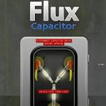
Back to the Future
Last month USC hosted a Future of Computing seminar
  Looking forward 25 years into the future
For 30 minutes let me take you back to a time when there were:
  No computer science departments
  No personal computers
    No computer mouse
    No desktop
  No word processing software (typewriters)
  No Internet
  No web
  No cellphones
Notes:
I was fortunate in the a math professor had worked for IBM and convinced them to donate the computer to the school; It was a hands-on machine
I was mesmerized by programming
I went off to Wisconsin because they had a great math dept. I won a NYS College Teaching Fellowship that I could use out of state as long as I returned at taught in NY for at least 3 years.
I fulfilled my obligation

Slide 3
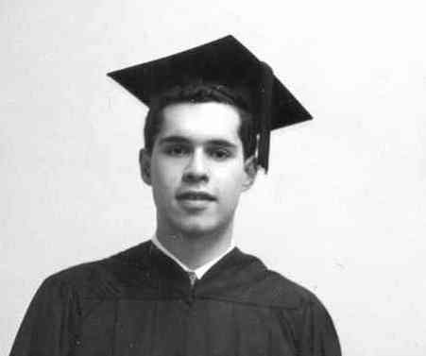
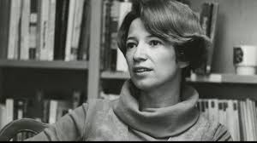
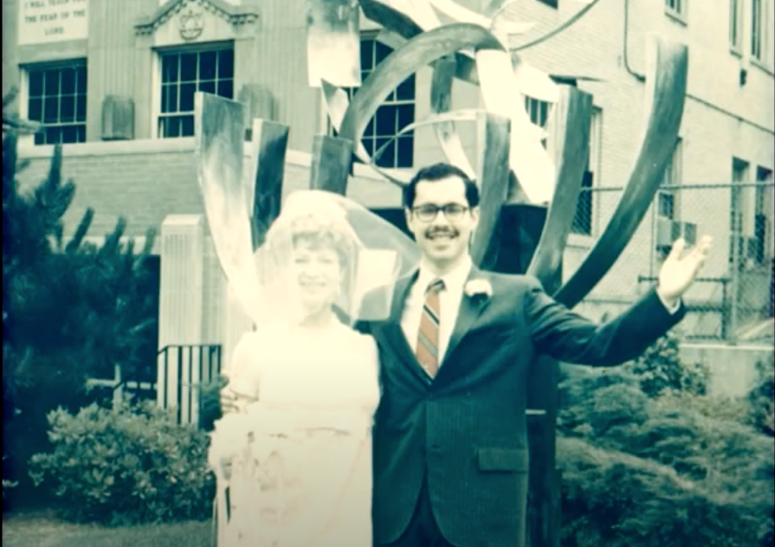
Some Background
1963 I programmed my first computer, an IBM 1620 in assembly language and FORTRAN
1964 I headed for a Ph.D. in mathematics at Univ. of Wisconsin – Madison,
1969 I graduated with
  a Ph.D. in computer science working on
  mathematical symbol manipulation
  A life partner, Maryanne Cline, Ph.D. History
I joined USC in Fall, 1973
Notes:
I was fortunate in the a math professor had worked for IBM and convinced them to donate the computer to the school; It was a hands-on machine
I was mesmerized by programming
I went off to Wisconsin because they had a great math dept. I won a NYS College Teaching Fellowship that I could use out of state as long as I returned at taught in NY for at least 3 years.
I fulfilled my obligation

Slide 4
Computer Science Departments Start to Grow
Purdue University gets the credit for being the first, formed in 1962
  Created as part of the division of mathematical science
At USC a CS program was formed in 1968, joint with EE and Math
  Numerical analysis was a lynch pin of the program, as it was in many places
  When I joined in ‘73 there were 5 faculty with S. Ginsburg the only tenured prof.
Philosophical Issues arose:
  Is CS a discipline? If so, is it a discipline of science, mathematics or engineering?
  Where do such departments belong?
    the college, engineering, within mathematics, separate school
Other departments soon followed, among them
  Univ. of Wisconsin (‘64), Stanford (‘65), CMU (‘65), Cornell (‘65), UC Berkeley (‘68), MIT (EECS)
Notes:
The philosopical issues would be debated during the 1970s and 1980s, but eventually got settled
Yes, computer science was a discipline separate from Math and separate from EE
Yes, computer science had scientific-like elements (mostly math), but also had engineering;
Departments sprung up wherever there was faculty interest and you can see many famous schools quickly added the field

Slide 5
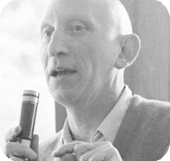
Alan J. Perlis, First Turing Award Winner
The ACM A.M. Turing Award, often called the "Nobel Prize of Computing,"
  Awarded by the Association for Computing Machinery's (ACM) most
  prestigious technical award, recognizing individuals for major,
  lasting contributions to the field of computing
I met him in 1969 when he helped found the department of computer science at CMU and I interviewed there
  Later he was president of ACM and in that role he was influential in defining the new field of computer science
  He later moved to Yale to start their computer science department
Notes:
I met Perlis at CMU while I was recruiting for an assistant professor job. Dr. Perlis was not very excited about my area, mathematical symbol manipulation.

Slide 6
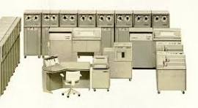
Machines to Love in the ‘60s-70s
The mainframe was king!
In the 1960s IBM was often referred to as “Snow White” with the other computer manufacturers jokingly called the “Seven Dwarfs”
  Burroughs, UNIVAC, NCR, CDC, Honeywell, General Electric and RCA
  During two of my summers I worked for IBM on their 7090/7094 series
  At Wisconsin I used CDC 1604 mainframe and a Burroughs 5500 stack machine
  When I arrived at USC the engineering school had only a small IBM 360
    Punch cards were sold in vending machines in Powell Hall
Notes:
The burroughs 5500 was optimized for executing ALGOL, a language that was very influential in the early days
It was designed by Bob Barton who I went to China with in 1978, soon after the Cultural Revolution ended
There was no assembly language as all software was written in an extended variety of ALGOL 60.
The B5000 was unusual at the time in that the architecture and instruction set were designed with the needs of software taken into consideration.

Slide 7
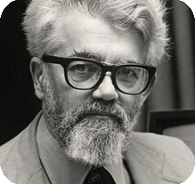
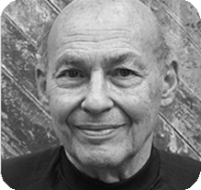
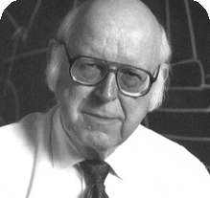
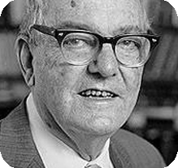
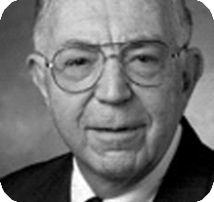
A.I. Gets Going in the 50s-60s
John McCarthy, MIT, coined the term artificial intelligence in1956 and introduced us to Lisp (list Processing)
Marvin Minsky, also MIT in his 1960 paper, “Steps toward Artificial Intelligence,” established symbol manipulation—divided into heuristic search, pattern recognition, learning, planning, and induction—to be at the center of A.I.
Allen Newell, works on understanding and modeling human cognition
Herbert Simon develops heuristic programming; wins Nobel prize in economics
Feigenbaum applied A.I. to expert systems
At USC, A.I. researchers worked on chess playing programs and included a chess grandmaster as an advisor
McCarthy
Minsky
Newell
Simon
Feigenbaum
Notes:
I first encountered an Alto when I was on sabbatical at MIT in 1978.
Just Steve Jobs when he toured PARC, it was clear that this was the next major step in computing;
Several Turing awards came out of that effort including
Doug Engelbart for the mouse
Alan Kay for object oriented programming, Smalltalk
Charles Thacker, for systems design
Bob Metcalfe for Ethernet

Slide 8
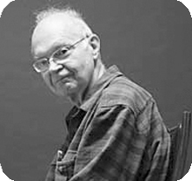
Two Early CS Research Themes
Analysis of Algorithms & Programming Languages
Knuth establishes “Analysis of Algorithms” as a field
of computer science
  Don Knuth’s The Art of Computer Programming vols 1, 2 and 3
  were published in ‘68, ‘69 and ’73
  Established algorithms as a fundamental field of CS
    vol 1 Fundamental Algorithms,
    vol 2 Semi Numerical Algorithms,
    vol 3 Sorting and Searching
I managed to get referenced for my work in his vol. 2
I managed to receive one of his $2.56 checks for an error I found
One of my first courses at USC was a graduate course on algorithms
  It is now a sophomore level class
Don Knuth
Turing winner #9

Slide 9
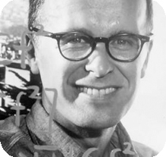
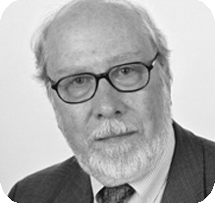
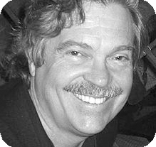
Two Early CS Research Themes
Analysis of Algorithms & Programming Languages
1957: FORTRAN (BACKUS)
1958: LISP (MCCARTHY)
1959: COBOL
1960: ALGOL
1964: BASIC
1970: PASCAL (WIRTH)
1972: SMALLTALK (KAY)
1972: C (RITCHIE, THOMPSON)
1980: ADA
1983: C++
1987: PERL
1991: PYTHON
1995: JAVA, JAVASCRIPT, PHP
JOHN BACKUS
TURING WINNER #12
JOHN MCCARTHY
TURING WINNER #6
NIKLAUS WIRTH
TURING WINNER #19
ALAN KAY
TURING WINNER #38

Slide 10
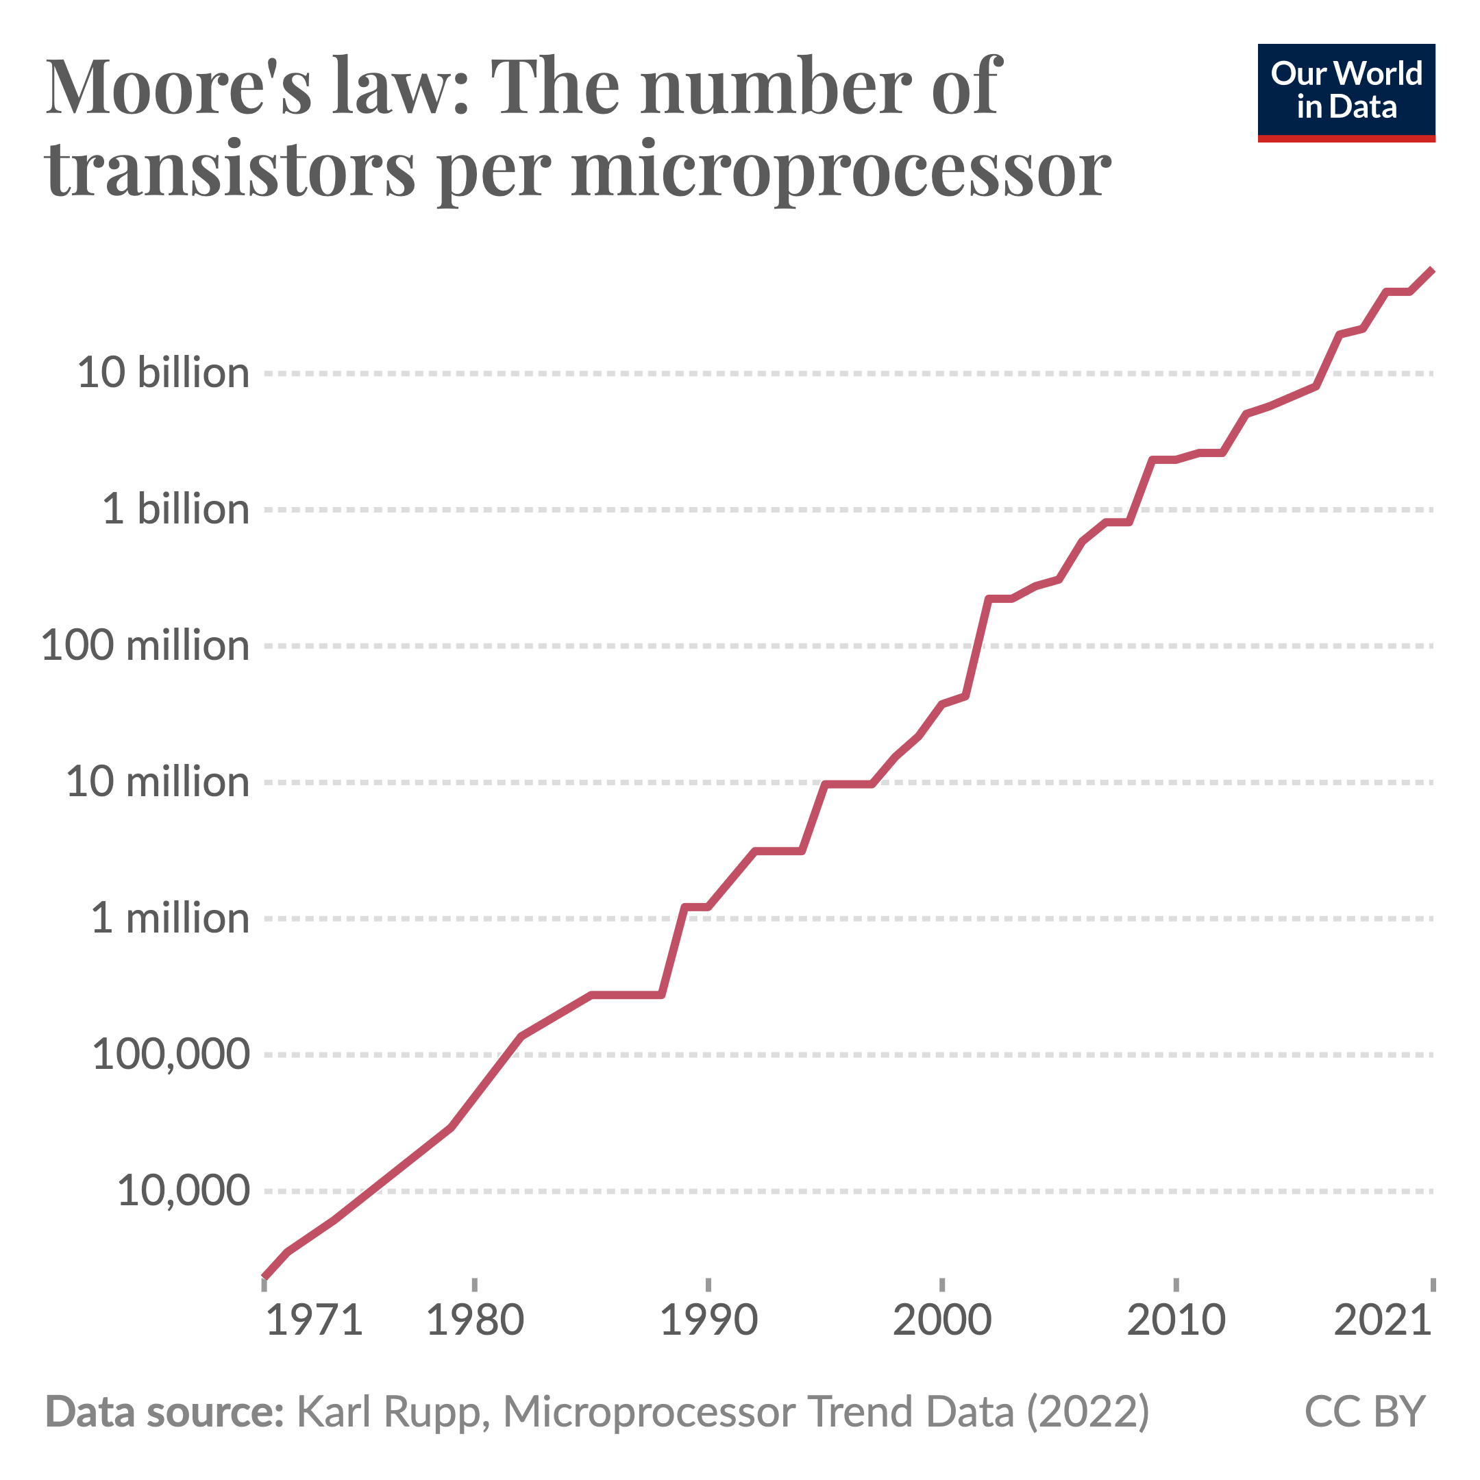
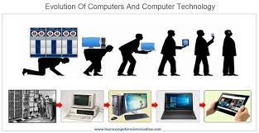
Tremendous Strides in Hardware 80s-90s
Though the Apple 1 appeared in 76, the Apple 2 in 77, and the IBM PC in 1981
The machine that revolutionized computing was the Xerox Alto
  Developed at Xerox PARC, it introduced us to a mouse, desktop metaphor, and a graphical user interface.
The rise of computer workstations, characterized by high-performance, single-user systems, primarily occurred in the early to mid-1980s
Companies like DEC, Apollo Computer, and Sun Microsystems, dominated technical computing for about 20 years.
Lisp Machines from Symbolics and from Lisp Machines Inc.
Notes:
I first encountered an Alto when I was on sabbatical at MIT in 1978.
Just Steve Jobs when he toured PARC, it was clear that this was the next major step in computing;
Several Turing awards came out of that effort including
Doug Engelbart for the mouse
Alan Kay for object oriented programming, Smalltalk
Charles Thacker, for systems design
Bob Metcalfe for Ethernet

Slide 11
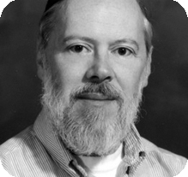
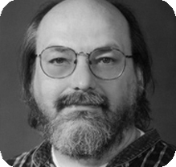
Growth of UNIX, C and Open Source Software
The C programming language, developed at AT&T Bell Labs and designed for writing an operating system made it ideal for porting to numerous machine architectures
The UNIX operating system, built in C and distributed for a nominal fee was the birth of open software
As a result, C and Unix could be found on numerous workstations e.g. SUNs, Apollos, PDPs, SGI
Today’s Mac’s and even iPhones contain original UNIX software due in part to Steve Jobs, who visited USC to sell us NeXt machines
With other USC faculty I started a software venture, Quality Software Products which built and sold UNIX application software
  It lasted 10 years with products: Q-calc, Exclaim, Maitre D, Project Management
Dennis Ritchie
Turing winner #18
Ken Thompson
Turing winner #18
Notes:
Developed at Bell Labs, their goal was to create a much simpler OS than Mutics, a large multi-tasking OS that was quite popular at the time.
It slowly took hold at Bell Labs adding features and porting it to PDP7, PDP11
IN 1973 UNIX was entirely re-written in C
Happily the Bell System had settled an antitruist case and was forbidden from entering any business other than common carrier communications. As such they willingly distributed it to anyone who wanted it
https://en.wikipedia.org/wiki/History_of_Unix

Slide 12
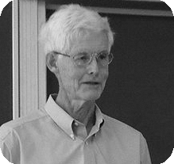
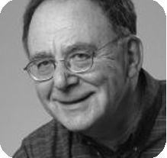
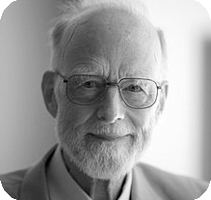
CS Theory Expands
Chasing P vs NP
Stephen Cook’s 1971 paper establishes NP-Completeness* and shows that Boolean satisfiability is a member of the class
  It is in NP and any problem in NP can be reduced to SAT in polynomial time
In the 70s I published numerous papers on NP problems
Chasing Program Verification
  Hoare logic, a basis for verifying computer programs using pre-conditions, post conditions, and logical rules
Stephen Cook
Turing Winner #17
Dick Karp
Turing Winner #20
Hoare later pointed out that proving programs
“did not solve the problems he intended”
Tony Hoare
Turing winner #15

Slide 13
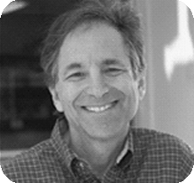
Leonard Adleman
Father of DNA Computing
With Ron Rivest and Adi Shamir he showed how to make public-key cryptography useful.
DNA computing is a method of using DNA to perform calculations and store information.
Adleman’s 1994 experiment demonstrated the feasibility of using DNA to solve the Hamiltonian path problem
Computations are performed by manipulating DNA molecules through biochemical reactions
Key advantage: DNA computing has the ability to perform massive parallel processing
Leonard Adleman
Turing winner #37
Notes:
22 + 27 + 30 = 79 winners from1966 to 2024
By my count
We see some recurring themes
- programming languages (12 awardees)
Perlis, McCarthy, Dijkstra, Ritchie, Thompson, Iverson, Dahl, Nygaard, Naur, Liskov,
- artificial intelligence (7 awardees)
Minsky, Newell, Simon, Feigenbaum, Reddy, Barto, Sutton, Pearl,
- theoretical computer science
- hardware

Slide 14
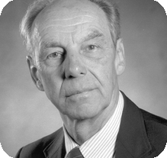
CS Departments Anchored by Turing Winners
Cornell – Hartmanis, Hopcroft, Salton, others
CMU – Perlis, Newell, Simon, others
Stanford – Forsythe, Knuth, Feigenbaum, others
U.C. Berkeley – Zadeh, Harrison, Karp, others
U.C.L.A. – Estrin, Kleinrock, Melkanoff, others
MIT – McCarthy, Minsky, others
US News&World Reports
CS Ranking 2024:
1. MIT
2. CMU
3. STANFORD
4. BERKELEY
5. ILLINOIS
. . .
21. USC
Juris Hartmanis
Turing winner #28
Allen Newell
Turing Winner #10
Herb Simon
Turing winner #10
Ed Feigenbaum
Turing winner #29
Marvin Minsky
Turing winner #4

Slide 15
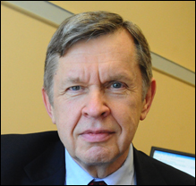
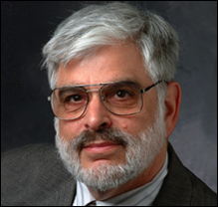
Single Textbooks Define and Dominate the Curriculum*
For the Algorithms course
  Introduction to Algorithms, Cormen et al
  Fundamentals of Algorithms, Horowitz & Sahni
For the Data Structures course
  Fundamentals of Data Structures, Horowitz & Sahni
For the Discrete Math course
  Concrete Mathematics, Graham et al
For the compilers course
  Compilers; Principles, Techniques and Tools Aho & Ullman
For the AI course
  Artificial Intelligence: A Modern Approach, Norvig et al
For the Database course
  Database System Concepts, Silberschatz et al
For the Computer Graphics course
  Computer Graphics: Principles and Practice, A. Van Dam et al
For the Operating Systems course
  Modern Operating Systems, Tanenbaum
Al Aho
Turing winner #53
Jeffrey Ullman
Turing Winner #53
*This list is heavily biased

Slide 16
A.I. Marches on in the 1980s
(over hyped expectations)
Edward Feigenbaum, the "father of expert systems"
A pioneer in AI, known for his work on knowledge-based systems
  He built the first expert system, the DENDRAL project to help chemists identify unknown molecules
  He defined “knowledge engineering” as a set of rules and procedures for problem solving and AI researchers started to build expert systems
Among the claims cited included:
  Automating repetitive tasks
  Reduce human errors
  Discover things humans may miss
But in the end they failed to have the impact on society that was predicted
  They lacked common sense in making decisions
  Could not explain the logic behind a decision
  They were inflexible to a changing environment
Turing Winner #29

Slide 17
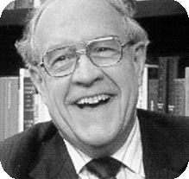
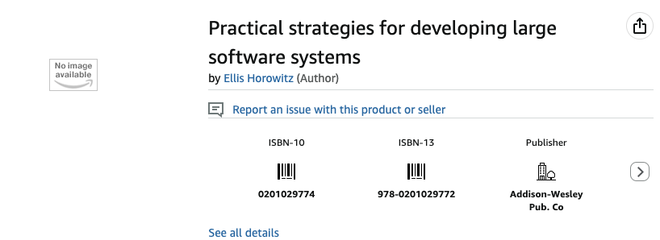
Software Crisis Leads to the field of Software Engineering
The 1960s and 70s saw many large systems projects
  Many of these contributed to vast cost overruns and long delays
One such example was IBM’’s OS/360 operating system, overseen by Fred Brooks
  “I made a multimillion-dollar mistake of not developing a coherent architecture before starting development
Brooks was the dedication speaker for the Salvatori Computer Science Center in 1976, where I had my office for most of my career
As an academic discipline, the NATO conference of 68-69, which included many other Turing winners: Dijkstra, Perlis, and Naur
In 1973 Boehm predicted that software costs would overwhelm hardware costs.
  As chair I recruited and hired him in 1993 and we wrote
  several research papers together
Fred Brooks
Turing winner #34
My first book

Slide 18
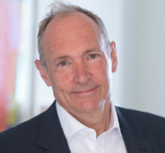
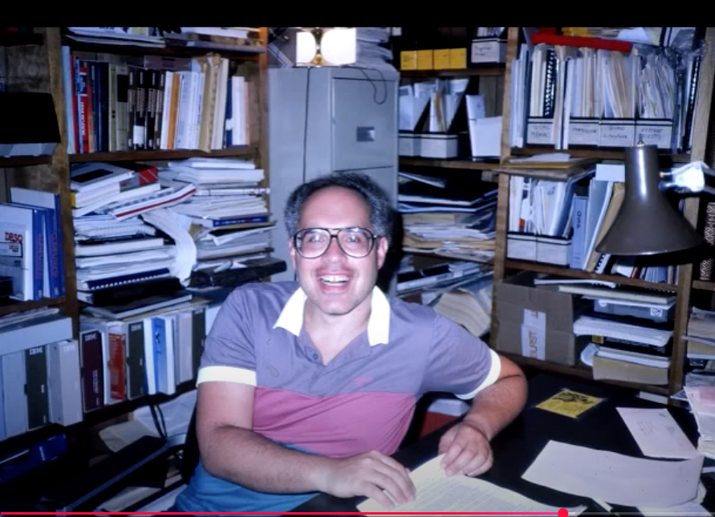
My Decade as Chair of CS, 1990 - 1999
Faculty Hiring
  Maja Mataric, Jernej Barbic, Neno Medvidovic, G.J. Halfond, Leana Golubchik, Victor Adamchik, Barry Boehm
  Joining together CS, ISI and ICT into a unified group
    ISI and ICT faculty appointments
The web comes into prominence
  Our first dept web site in 1995
  Introduced Web courses: graduate and undergraduate
Created our CS Advisory Board with funds for teaching faculty
Microsoft million dollar dept. equipment grant
Some of my later administrative activities
  Chair of the Engineering Faculty Council
  Working with our distance engineering network DEN
Tim Berners-Lee
Turing winner #51
Notes:
22 + 27 + 30 = 79 winners from1966 to 2024
By my count
We see some recurring themes
- programming languages (12 awardees)
Perlis, McCarthy, Dijkstra, Ritchie, Thompson, Iverson, Dahl, Nygaard, Naur, Liskov,
- artificial intelligence (7 awardees)
Minsky, Newell, Simon, Feigenbaum, Reddy, Barto, Sutton, Pearl,
- theoretical computer science
- hardware

Slide 19
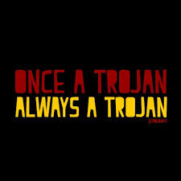
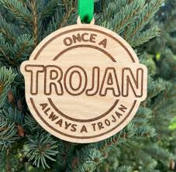
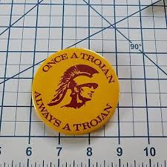
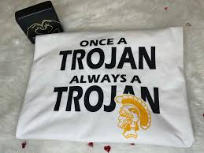
USC HAS BEEN A WONDERFUL PLACE to work with students, with colleagues, to teach, and to do research
Notes:
22 + 27 + 30 = 79 winners from1966 to 2024
By my count
We see some recurring themes
- programming languages (12 awardees)
Perlis, McCarthy, Dijkstra, Ritchie, Thompson, Iverson, Dahl, Nygaard, Naur, Liskov,
- artificial intelligence (7 awardees)
Minsky, Newell, Simon, Feigenbaum, Reddy, Barto, Sutton, Pearl,
- theoretical computer science
- hardware

